Slide 1
Introduction to Image classification with Convolutional Neural Net
Simon Johansson

Slide 2
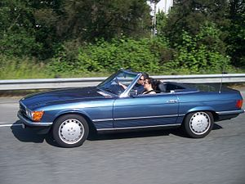

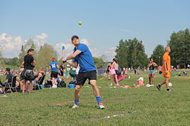
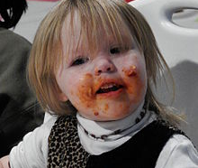
Intelligence Ability to learn
Intelligence Ability to learn
Notes:
For a quite

Slide 3
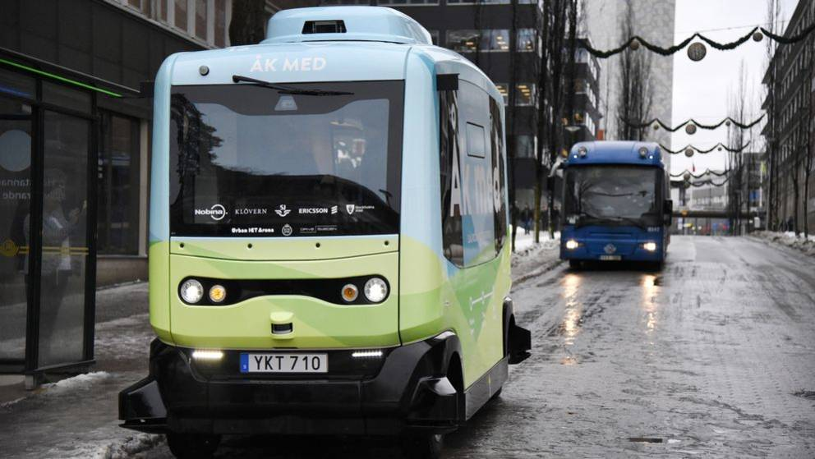
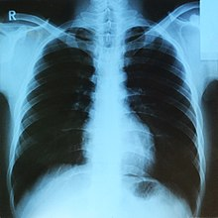
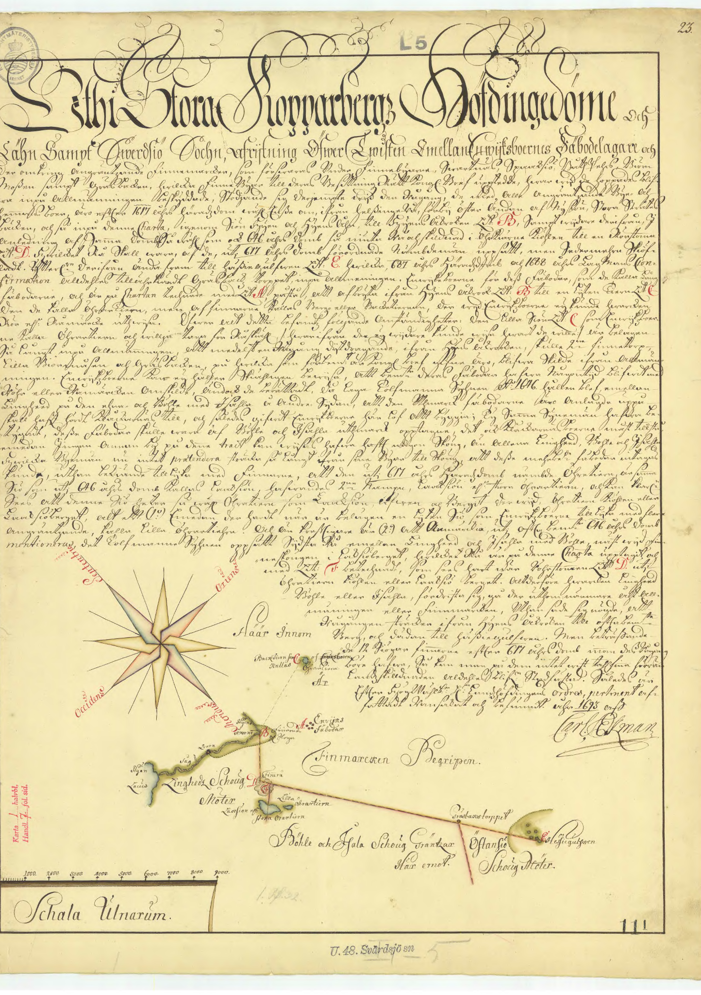
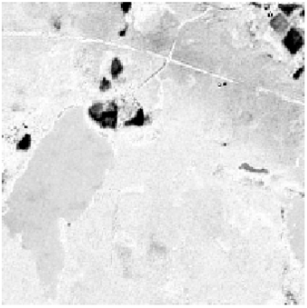
Image processing Computer vision
Notes:
For a quite

Slide 4
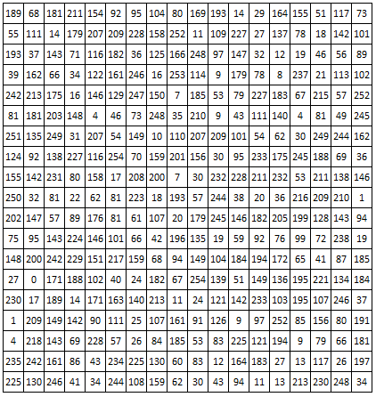
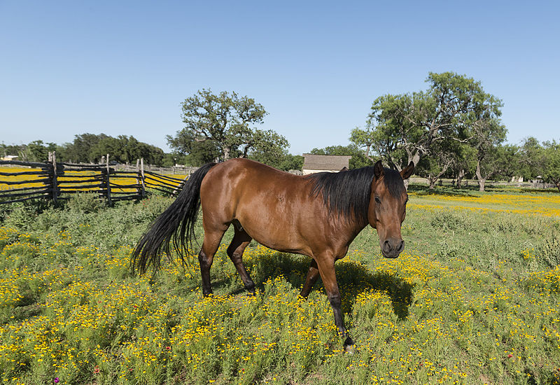
Eyesight Ability to se patterns, recognize objects and detect movements
Notes:
For a quite

Slide 5
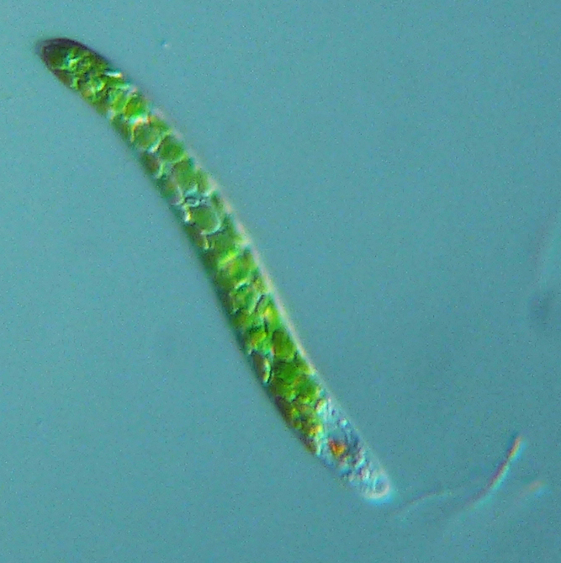
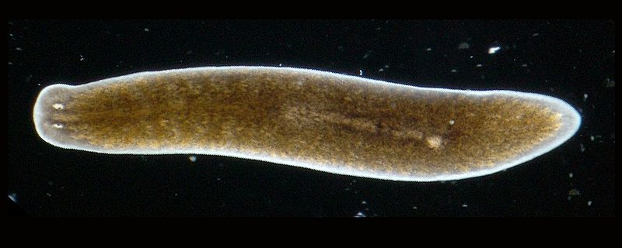
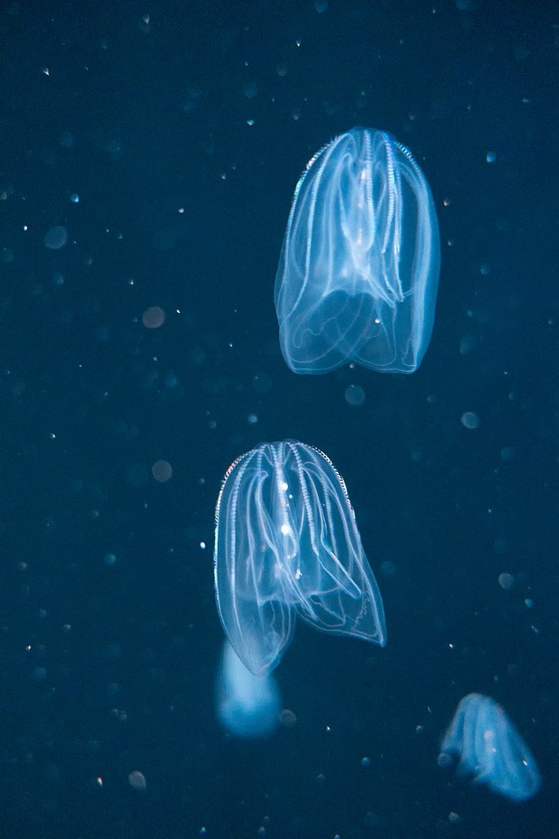
Planaria: Two collections of cup formed regions with proteins sensitive to light
Euglena: Proteins sensitive so sunlight. Now where to look for food
600 million years ago
Bell jelly fish: Reacts different on different colors. Green relax, purple flees.

Slide 6
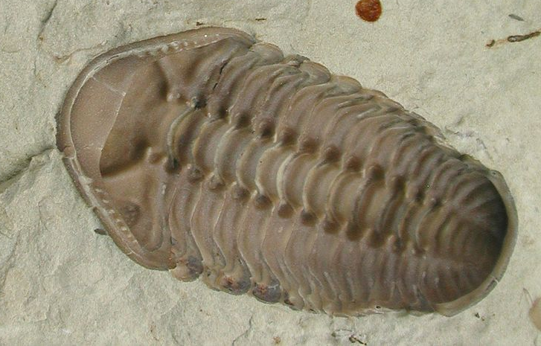
During this time of 15-35 million years many new species developetd. One hypothesis is that the delopment of eyes created a race between predators and pray.
If eyes was the cause of this race is hard to know, but cetainly it was a benefit to see.
Kainops invius: Trilobite developed during the cambrian explosion.
~520 mya – Cambrian explosion

Slide 7
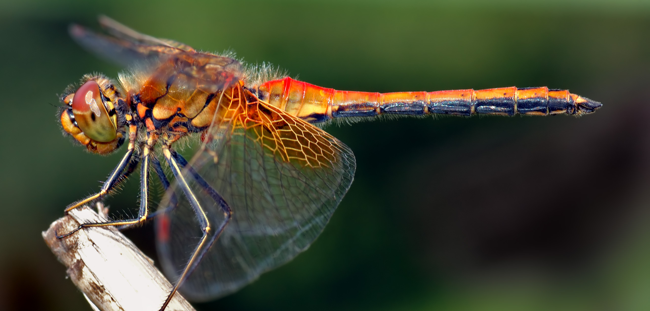
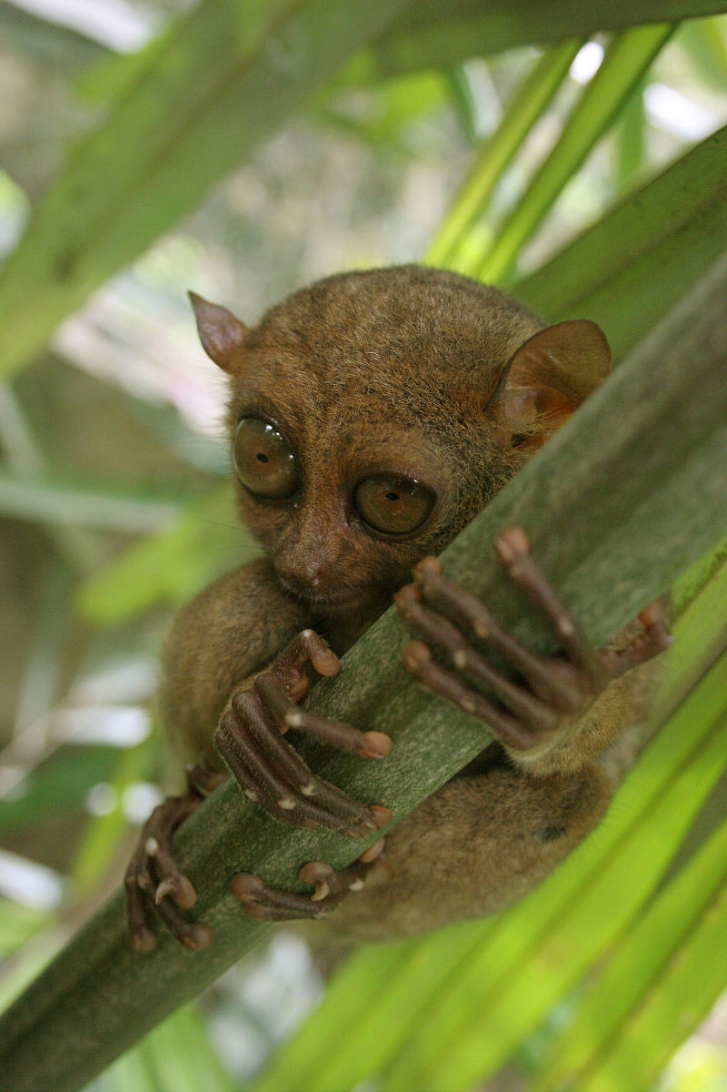
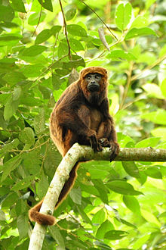
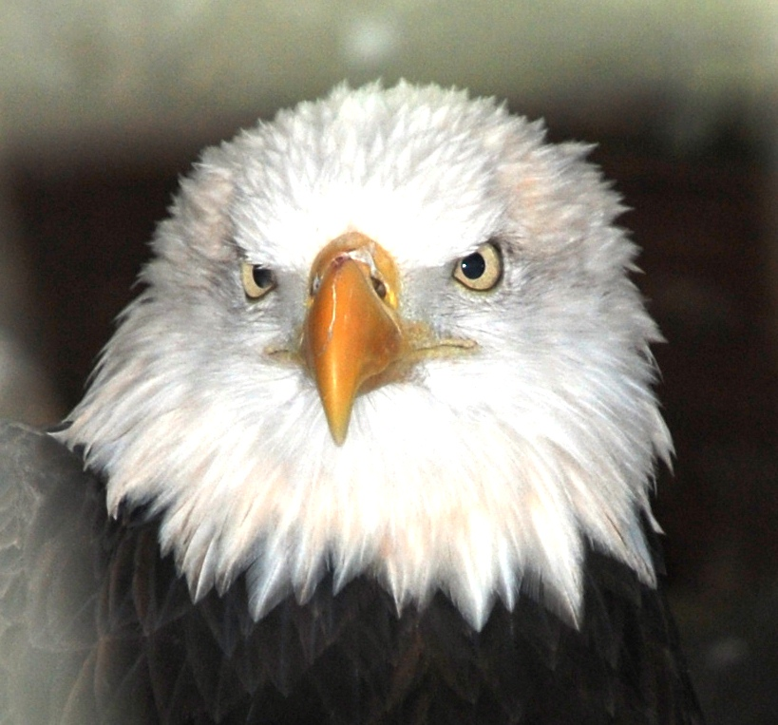
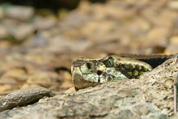
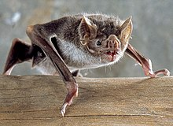
Dragonflies: 30’ photoreceptors with 360 degrees view. 5 times higer view frequenzy then humans. Uses motion camoflage when attacking.
Eagles: Can spot a rabbit from 3km. Eyes at size of a human
Primates: Developed receptors for red light. To distiguish nutrious fresh leavs.
Pit Viper: Beeing able to see temperature by hole close to nostril.
Tarsier: Eyes almost big its skull. Good night vision and binocular field
Different specializations of sight
Notes:
Egles has so tightly fitted eyes that they can barely move

Slide 8




Processing of views
Notes:
Prata lite extra om elefanten som är ett tydligt exempel på att mänskliga hjärnan tittar på mönster som är nära varandra.

Slide 9
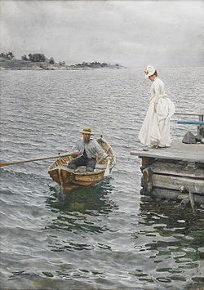
The impressionists had a feeling for what features that was important for our eyes.
Looking at a painting from a distans makes it appear as a photo.
Anders Zorn – Sommarnöje 1886
Notes:
For a quite

Slide 10
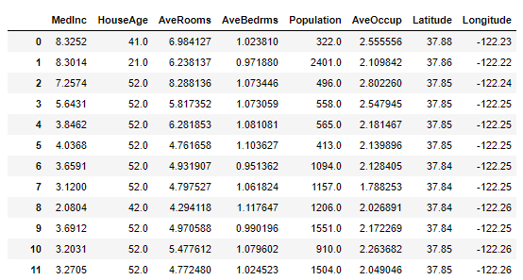
Difference between images and structured data
To make the image understand More important with nearby pixels similar with time dependent signals where measures close in time are more important.
Notes:
For a quite

Slide 11
Computers can take pictures
But computers doesn’t understand or see images just displays them.
The eye and brain where developed over 600milj years.
How can we make the computer understand what's in an image
Notes:
FoFrom Fei Fei Lei

Slide 12
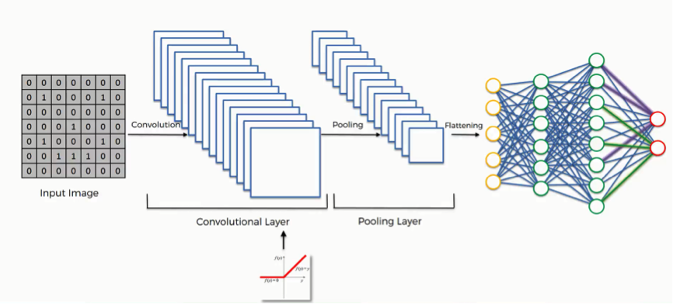
Principles of convolutional net
Gradient descent and backpropagation is used to update values in filters and bias.

Slide 13
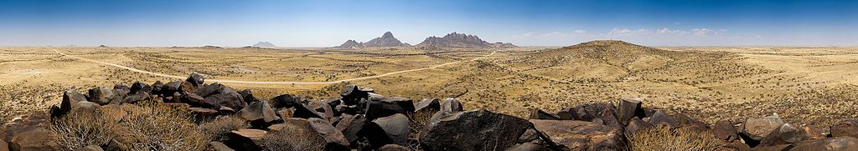
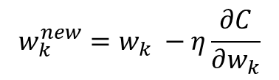
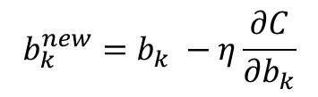
Minimizing Cost - Gradient Decent
$$w_{k}^{new}=w_{k} −η\frac{∂C}{∂w_{k}}$$
$$b_{k}^{new}=b_{k} −η\frac{∂C}{∂b_{k}}$$

Slide 14
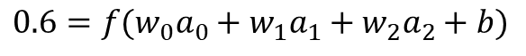
Backpropagation
f is the activation function, ReLU, tanh, sigmoid or…..
Input
$$0.6=f(w_{0}a_{0}+w_{1}a_{1}+w_{2}a_{2}+b)$$
3 alternativs
Increase b
Increase w I
Change a_i
a₀
_{0.1}
_{0.3}
_{0.6}
₁
a₁
_{3.1}
_{0.8}
₀
a₂
_{0.4}
₄
_{0.2}
Output
Hidden

Slide 15

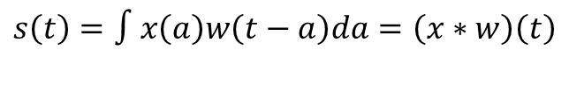
Convolution operator
Some mathematics (continuous):
$$s\left(t\right)=∫x\left(a\right)w\left(t−a\right)da=\left(x∗w\right)\left(t\right)$$
Note: The word convolutional in CNN is a little bit misleading in a mathematical sense.
The implementation is often the cross correlation. Those two operators are very similar.
The reason for this might be that in image processing convolutions has been used when a filter sliding over an image.
The difference between cross correlations and convolution appears when a non symmetric filter is used.
Notes:
For a quite

Slide 16
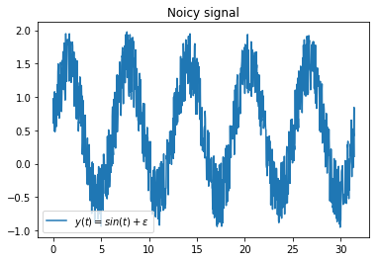
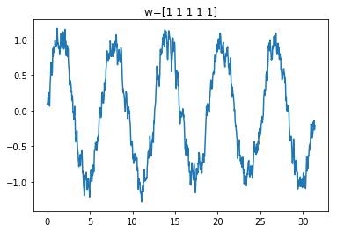
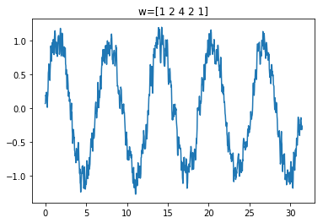
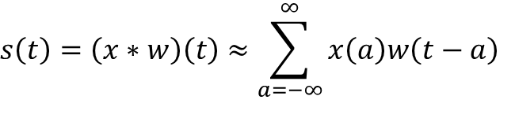
Convolution operator
Some mathematics (continuous):
$$s\left(t\right)=∫x\left(a\right)w\left(t−a\right)da=\left(x∗w\right)\left(t\right)$$
Discrete form:
$$s\left(t\right)=\left(x∗w\right)\left(t\right)≈\sum_{a=−∞}^{∞}{x\left(a\right)w\left(t−a\right)}$$
Notes:
For a quite

Slide 17
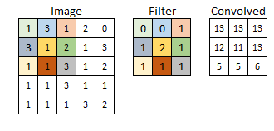
Convolution 2d
Notes:
For a quite

Slide 18
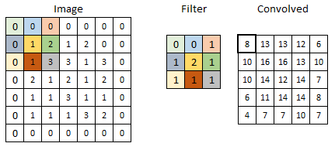
Convolution 2d – Zero padding
Notes:
For a quite

Slide 19
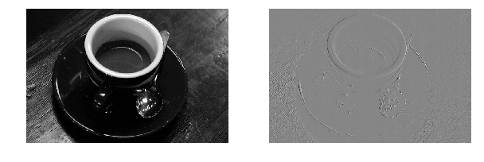
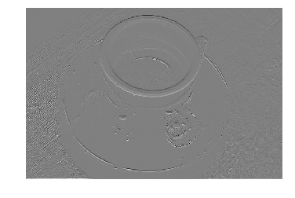

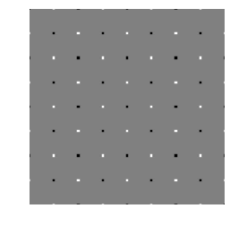
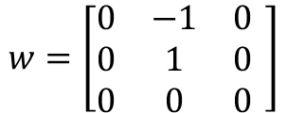
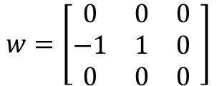
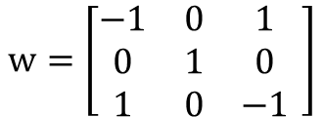
Examples of filters
$$w=\left[\begin{matrix}0 & 0 & 0 \\ −1 & 1 & 0 \\ 0 & 0 & 0\end{matrix} \right]$$
$$w=\left[\begin{matrix}0 & −1 & 0 \\ 0 & 1 & 0 \\ 0 & 0 & 0\end{matrix} \right]$$
$$w=\left[\begin{matrix}−1 & 0 & 1 \\ 0 & 1 & 0 \\ 1 & 0 & −1\end{matrix} \right]$$
Notes:
For a quite

Slide 20
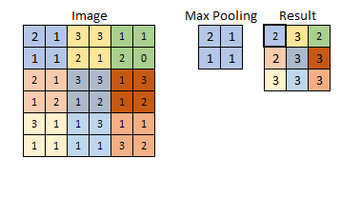
Pooling layer
Notes:
For a quite

Slide 21
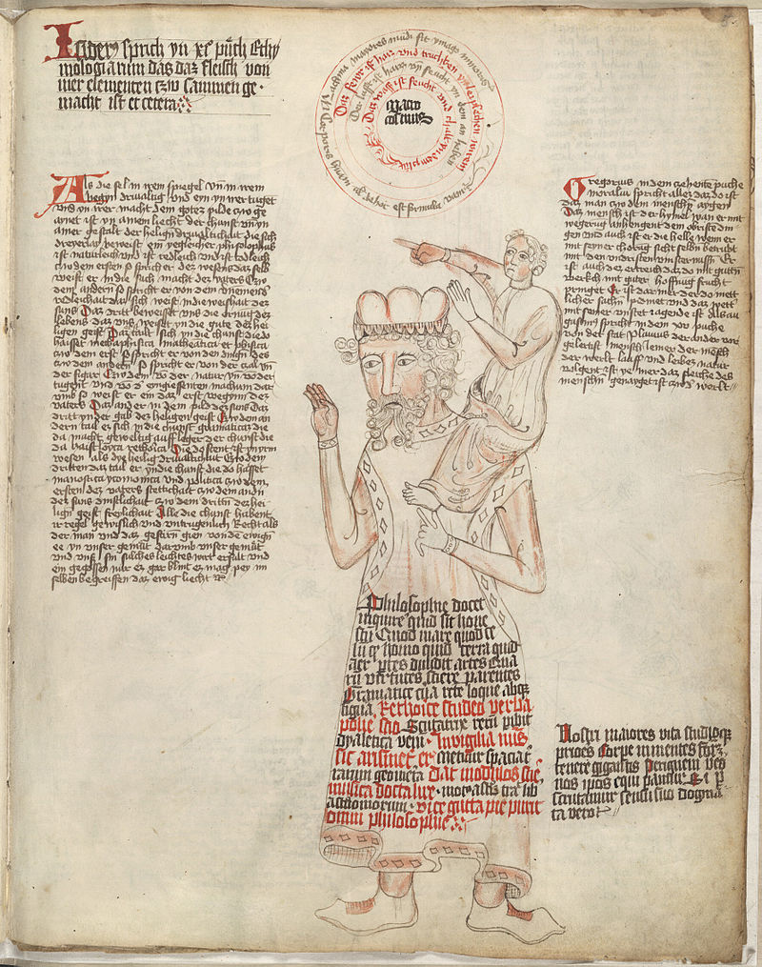
On the shoulders of Giants
Researches at Universities and large companies have invested a lot of time and money to develop good network designs and training those.
While developing those good networks a lot of designs has been evaluated and rejected.
It is always good to start the network from a network with trained wheights.
Training VGG16 from scratch takas a few days on GPU and weeks on CPU.

Slide 22
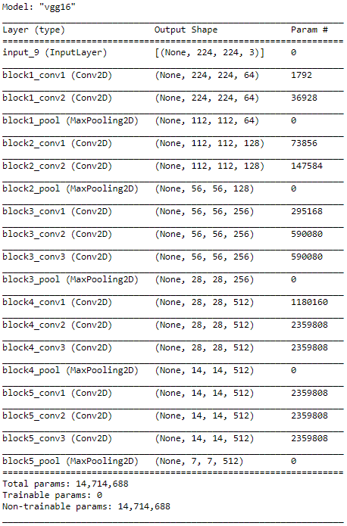
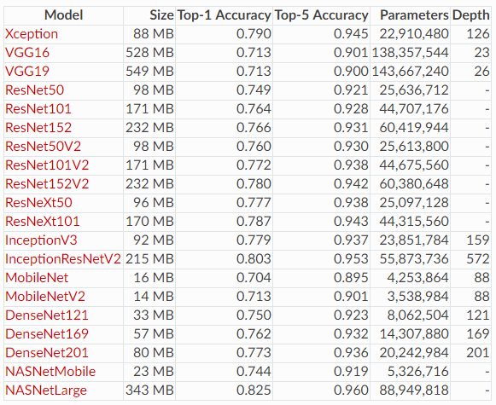
Models available in Keras
Notes:
For a quite

Slide 23
Lack of data - Data Augumentation
Modify images
Rotate
Zoom
Skew
Flip
Generate syntetic data
GDPR safe
Mathematicly describe symbols and create paths

Slide 24
Lets do some coding!
https://colab.research.google.com
Click on github – search for simjoh
Click on repository AI-Lab-Neural-Net-and-Python
Need for google account
Using myBinder.org
No account needed
https://mybinder.org/
Search for RegionVasterbotten
OR
Use local repository
This will need some editing of the code to load local files instead from git

Slide 25
URLs
Stanford CS231
https://www.youtube.com/watch?v=LxfUGhug-iQ
Fei Fei Lei - TED
https://www.youtube.com/watch?v=40riCqvRoMs
YouTube channel - 3Blue1Brown
Notes:
For a quite

